Slide 1
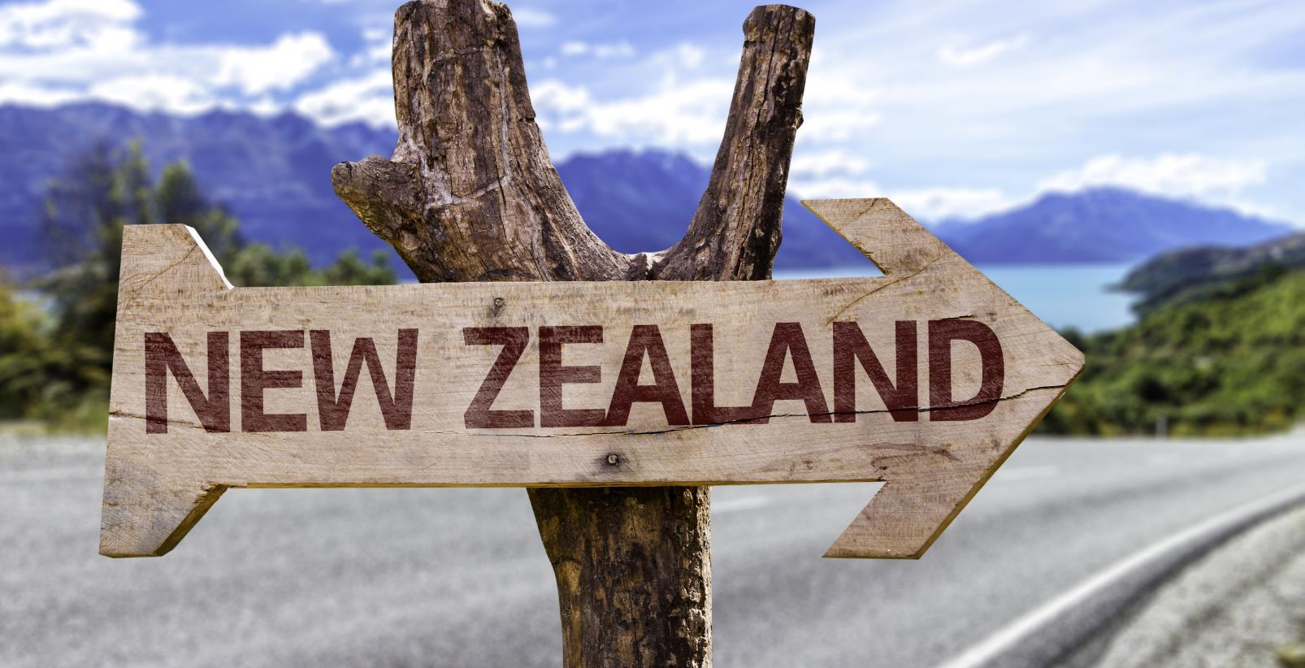
Mood of the Nation
New Zealanders' perceptions of international visitors
November 2019

Slide 2
Introduction
New Zealand’s ability to deliver a world-class visitor experience has seen the value of international tourism surpass $17 billion per year and retain its place (for the 4th successive year) as New Zealand’s top export earner.
The warm welcome of New Zealanders plays a critical role in the success of New Zealand as a desirable visitor destination, so ‘Mood of the Nation’ research is conducted twice a year to provide insight into New Zealanders’ sentiment about international tourism. The results are used to help inform industry and government activity to ensure that the sector enriches our communities.
Top line results November 2019: Perceptions of New Zealanders
93% agree or strongly agree international tourism is good for the country
93% are proud that New Zealand is an attractive visitor destination
88% of New Zealanders take pride in welcoming international visitors
12% are aware of tourism’s value as New Zealand’s number one export industry
50% agree New Zealand attracts the right number of international visitors
24% think the number of visitors is too high
40% percent believe tourism puts too much pressure on New Zealand
32% agree or strongly agree that the government and industry are taking actions to address the pressures of tourism
7% think freedom camping puts pressure on New Zealand, a steady decline from March 2018

Slide 3
Contents
1
Research approach | 4
2
Key insights | 6
3
Detailed insights | 10
4
Appendix: measures by region | 34

Slide 4
Research approach
1

Slide 5

Research approach
Method and audience
An online survey of residents in New Zealand aged 18 plus
Sample sizes
From Nov-18, the sample size for this study is approx. n = 1080* people, to ensure we provide robust insights at the reginal level. We set minimum quotas to ensure sufficient representation from popular tourist destinations.
*n = 500 sample used prior to November 2018
Fieldwork dates
Weighting
Respondents were weighted by gender, age and region to be representative of the New Zealand population based on 2017 population estimates
Northland | n = 100
Auckland region | n = 100
Rotorua | n = 50
Gisborne / Hawkes Bay | n = 100
Taranaki | n = 100
Manawatu-Whanganui | n = 80
Wellington region | n = 100
Other North Island | n = 20
Christchurch | n = 100
Elsewhere in Canterbury | n = 50
Queenstown | n = 100
Elsewhere in Otago | n = 50
West Coast | n = 100
Other South Island | n = 20
Wave 1: 2nd to 6th December, 2015 | Wave 5: 13th to 23rd November, 2017 | Wave 9: 4th to 27th November, 2019
Wave 2: 17th March to 2nd April, 2016 | Wave 6: 5th to 21st March, 2018
Wave 3: 7th to 17th November, 2016 | Wave 7: 31st October to 13th November, 2018
Wave 4: 13th to 22nd March, 2017 | Wave 8: 26th February to 10th March 2019

Slide 6
Key insights
2

Slide 7
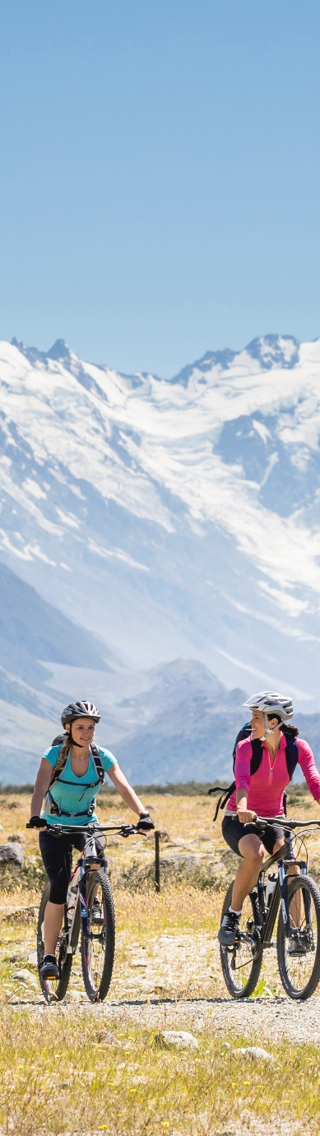
KEY INSIGHTS (page 1 of 3)
The vast majority of New Zealanders continue to agree that international tourism is good for New Zealand
New Zealanders remain welcoming of international visitors and are proud that their country is an attractive tourist destination
Over time there has been an increase in perceptions that international visitor numbers are too high
IS INTERNATIONAL TOURISM GOOD FOR NEW ZEALAND?
93%
Strongly agree
or agree
48%
AGREE
45%
STRONGLYAGREE
November 2019
PERCEPTIONS THAT CURRENT NUMBER OF VISITORS IS TOO HIGH
Significantly higher / lower
than previous wave at 95%
7

Slide 8
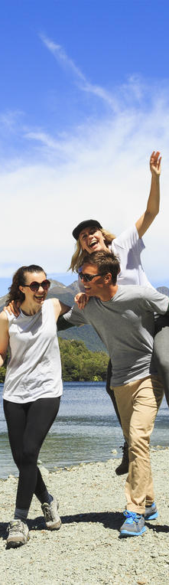
KEY INSIGHTS (page 2 of 3)
The proportion of New Zealanders who think that international tourism puts too much pressure on New Zealand have stabilised, following an increase from 2015 to 2017
This view is driven by two key factors (1) perceptions that New Zealand lacks the infrastructure to support the growing number of visitors; (2) perceived negative impact of tourism on the environment
New Zealanders’ views on the impact of tourism on the country continue to be strongly influenced by personal experiences and information from national media outlets
PERCEPTIONS THAT TOURISTS PUT TOO MUCH PRESSURE ON NEW ZEALAND
Pressure on infrastructure
Environmental damage
National Parks overcrowded
Top 5
ways tourism applies pressure
Increased traffic congestion
Disrespect (e.g. littering)
Significantly higher / lower
than previous wave at 95%
8

Slide 9
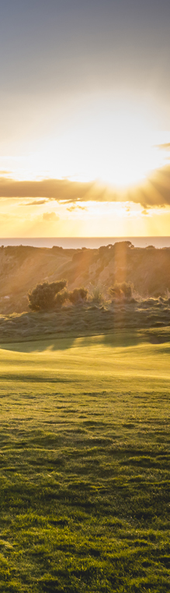
KEY INSIGHTS (page 3 of 3)
Over half of New Zealanders say that the predicted international visitor growth is ‘too much’
This metric, currently at 52%, is stable compared to March this year, but has been trending upwards over the last few years
PERCEPTIONS OF PREDICTED GROWTH
Significantly higher / lower
than previous wave at 95%
9

Slide 10
Detailed insights
3

Slide 11
The vast majority of New Zealanders agree that international tourism is good for New Zealand
International tourism is good for New Zealand
% agree, 18+ year olds
Base: New Zealanders aged 18 plus: Mar-17 n = 500 | Nov-17 n = 501 | Mar-18 n = 555 | Nov-18 n = 1084 | Mar-19 n = 1083 | Nov-19 n = 1081
Significantly higher / lower than previous wave at 95%

Slide 12
Generally speaking, New Zealanders agree that they are welcoming of and open to international visitors
Attitudes towards international visitors
% agree, 18+ year olds, Nov-19
Personal perceptions
Perceptions of how other New Zealanders feel
Base: New Zealanders aged 18 plus: Nov-19 n = 1081
Significantly higher / lower than previous wave at 95%

Slide 13
Personal experience and information from national media outlets have the most influence on New Zealander's opinion of international tourism
What influences the opinions on international tourism
18+ year olds, Nov-19
Level of influence
1st most significant | 2nd most significant
42% | 18%
39% | 19%
9% | 36%
5% | 12%
5% | 15%
1
What I experience first-hand in my daily life
2
What I see / hear about tourism from national media outlets
3
What I hear from friends / family / colleagues that they experience first hand in their daily lives
4
What I see / hear about tourism from local media outlets
5
What I see / hear about tourism from regional media outlets
Base: New Zealanders aged 18 plus: Nov-19 n = 1081
Significantly higher / lower than previous wave at 95%

Slide 14
The majority of New Zealander’s remain unaware of international visitor volume
Knowledge of annual visitor numbers
%, 18+ year olds
Actual number | 3m | 3m | 3.4m | 3.5m | 3.7m | 3.7m | 3.8m | 3.8m | 3.8m
Base: New Zealanders aged 18 plus: Dec-15 n = 502 | Mar-16 n = 520 | Nov-16 n = 521 | Mar-17 n = 500 | Nov-17 n = 501 | Mar-18 n = 555 | Nov-18 n = 1084 | Mar-19 n = 1083 | Nov-19 n = 1081
Significantly higher / lower than previous wave at 95%

Slide 15
Most New Zealanders continue to overestimate the number of people directly or indirectly employed in the tourism industry
Knowledge of how many New Zealand workers employed in the tourism industry (directly or indirectly)
%, 18+ year olds
Correct answer | 1 in 8 | 1 in 8 | 1 in 8 | 1 in 8 | 1 in 8 | 1 in 8 | 1 in 8 | 1 in 8 | 1 in 8
Base: New Zealanders aged 18 plus: Dec-15 n = 502 | Mar-16 n = 520 | Nov-16 n = 521 | Mar-17 n = 500 | Nov-17 n = 501 | Mar-18 n = 555 | Nov-18 n = 1084 | Mar-19 n = 1083 | Nov-19 n = 1081
Significantly higher / lower than previous wave at 95%

Slide 16
New Zealanders are still largely unaware of the scale and value of international tourism, with only a small proportion realising it is New Zealand’s largest export industry
Knowledge of the value of the tourism industry
%, 18+ year olds
Base: New Zealanders aged 18 plus: Mar-17 n = 500 | Nov-17 n = 501 | Mar-18 n = 555 | Nov-18 n = 1084 | Mar-19 n = 1083 | Nov-19 n = 1081
Significantly higher / lower than previous wave at 95%

Slide 17
The proportion of New Zealanders who think New Zealand attracts too many international visitors is stable
Perceptions of whether New Zealand attracts too few/too many international visitors
%, 18+ year olds
Based on perceived number of current visitors
Base: New Zealanders aged 18 plus: Dec-15 n = 502 | Mar-16 n = 520 | Nov-16 n = 521 | Mar-17 n = 500 | Nov-17 n = 501 | Mar-18 n = 555 | Nov-18 n = 1084 | Mar-19 n = 1083 | Nov-19 n = 1081
Significantly higher / lower than previous wave at 95%

Slide 18
When cited the actual number of international visitors, half of New Zealanders agreed that it is just right
Perceptions of whether New Zealand attracts too few/too many international visitors
%, 18+ year olds
Based on actual number of current visitors
Base: New Zealanders aged 18 plus: Dec-15 n = 502 | Mar-16 n = 520 | Nov-16 n = 521 | Mar-17 n = 500 | Nov-17 n = 501 | Mar-18 n = 555 | Nov-18 n = 1084 | Mar-19 n = 1083 | Nov-19 n = 1081
Significantly higher / lower than previous wave at 95%

Slide 19
”
Themed verbatim reasons for there being too many international visitors (24%)
Overcrowding
Lack of infrastructure
Environmental damage
“I don't think some of our tourist attractions are equipped to handle the volume of tourists they get”
“Hotspot (e.g. Queenstown) tourist overload”
“Some regions are over touristy and others barely touched”
“Too many campers / campervans on the road, especially in the South Island”
“I have seen how congested the South Island tourism spots are becoming”
“It getting too packed on tracks and roads now”
“Some destinations cannot deal with the numbers coming through and are therefore suffering from it and/or the experience is decreased”
“Some tourist areas can be too busy for my liking but I know it's an important industry”
“We don't have the infrastructure to handle the numbers coming here and many places are suffering as a result”
“I often hear of regions unable to cope with the numbers of tourists they receive”
“Our environment, services and infrastructure cannot handle the current numbers at certain times of year”
“Because the infrastructure i.e. hotels and accommodation plus freedom camping facilities are at stretching points of stress and overuse”
“Infrastructure is not coping despite increased funding”
“Infrastructure is not keeping up with demand. Also road congestion in Queenstown area is is nothing short of diabolical”
“I don't think we have the infrastructure (especially transport) to sustain the current level of tourism”
“I worry about the impact on the environment”
“Freedom campers are destroying our natural environment”
“We need the tourists but too many can be damaging to the local environment if we don’t manage it properly which is what is happening in a lot of small towns”
“Because of freedom camper’s [poor] toilet disposal habits”
“From what I've heard there's a lot of harmful impact on the environment to New Zealand from tourism”
“Some [tourists] are not very respectful of our country, our environment, or our rules”
“The damage they cause to our environment”
“I'm worried about the lack of respect for our environment”
Base: n = 285

Slide 20
”
Themed verbatim reasons for there being too few international visitors (19%)
Economic benefits and job creation
Managed expansion
“Declining growth. Need to increase GDP”
“The more tourists that come to New Zealand then the more jobs are created to support that industry and the spin-offs that tourism creates”
“Because I work in Hospitality field and we need more. End of story!”
“We need more tourists to make our country better economically”
“Tourism is so great for our economy, there could always be more visitors but I think more is better than less”
“I see capacity to accommodate more overseas visitors, and they are a great way of earning income for the country. plus in Rotorua we locals have many great amenities to enjoy which would not be there if there were no tourist”
“Tourism is good for business, keep them coming”
“The more international visitors NZ gets increases the amount of foreign currency that NZ gets and as such increases the spending ability of New Zealanders”
“We're a small country with no real export economy except for primary industries; we need more foreign currency coming into the country”
“Tourism contributes towards a strong economy and we need to be less reliant on farming exports”
“Don’t want them coming and ruining things like our nature. But contribute a lot to the economy”
“More is always good for business, but it needs to be done in a sustainable way”
“I think we have more capacity, but the key is distributing tourists to new destinations”
“The more visitors the better for the economy however the infrastructure needs to be able to cope”
“We need to reduce the numbers but get a better spend from each traveller”
“Tourism is big money however appears to be expanding faster than existing infrastructure can accommodate”
“The tourists need to be spread all over the country not just in one or 2 places. In some places the tourist numbers need to increase so that the demand creates growth in that region”
“I think there is still room for more as long as the infrastructure is there”
“NZ can handle more visitors provided the infrastructure is put in place”
Base: n = 221

Slide 21
The proportion of New Zealanders who think the current number of international tourists puts too much pressure on New Zealand has been stable over the last year, at 40% in November 19
Perceptions that tourists put too much pressure on New Zealand
%, 18+ year olds
Base: New Zealanders aged 18 plus: Dec-15 n = 502 | Mar-16 n = 520 | Nov-16 n = 521 | Mar-17 n = 500 | Nov-17 n = 501 | Mar-18 n = 555 | Nov-18 n = 1084 | Mar-19 n = 1083 | Nov-19 n = 1081
Significantly higher / lower than previous wave at 95%

Slide 22
Pressure on infrastructure continues to be the top concern New Zealanders have with international tourism, but this sentiment has reduced from earlier surveys
Perceptions of how tourism puts pressure on New Zealand
%, those who say “too much pressure”, Nov-19
Mar-19 | Nov-18 | Mar-18
44% | 44% | 36%
20% | 19% | 17%
10% | 6% | 3%
25% | 14% | 14%
10% | 11% | 11%
16% | 22% | 18%
11% | 10% | 6%
10% | 12% | 11%
New this wave
11% | 9% | 16%
Base: Those who say “too much pressure”: Nov-19 n = 457
Notes: Based on unprompted verbatim
Significantly higher / lower than previous wave at 95%

Slide 23
The proportion of New Zealanders who believe that some places are under more pressure than others has dropped back to levels seen in 2017 and 2018, currently at 35%
“Some places are under more pressure”
% agree, 18+ year olds
Base: New Zealanders aged 18 plus: Dec-15 n = 502 | Mar-16 n = 520 | Nov-16 n = 521 | Mar-17 n = 500 | Nov-17 n = 501 | Mar-18 n = 555 | Nov-18 n = 1084 | Mar-19 n = 1083 | Nov-19 n = 1081
Significantly higher / lower than previous wave at 95%

Slide 24
Queenstown and Auckland continue to be the top locations perceived to be under the most pressure; perceptions of pressure in Rotorua have significantly decreased, while the West Coast have increased compared with March of this year
Which places? – top 10
%, Nov-19, those who say some places are under more pressure
Mar-19 | Nov-18 | Mar-18
60% | 65% | 64%
36% | 35% | 46%
28% | 25% | 29%
14% | 14% | 17%
12% | 11% | 13%
5% | 6% | 9%
11% | 12% | 14%
13% | 12% | 13%
10% | 10% | 0%
10% | 11% | 7%
Base: Say some places are under more pressure: Mar-18 n = 211 | Nov-18 n = 402 | Mar-19 n = 436 | Nov-19 n = 436
Significantly higher / lower than previous wave at 95%

Slide 25
New Zealanders views of predicted visitor growth are stable compared to March 2019, with the proportion of New Zealanders who think this growth is ‘too much’ is at 52%
Attitudes towards predicted future growth of annual international visitors
%, 18+ year olds
Predicted growth | 4m in 4-5 yrs | 4m in 4-5 yrs | 4m in 2-3 yrs | 4m in 2-3 yrs | 4.5m in 4-5 yrs | 4.5m in 4-5 yrs | 5m in 4-5 yrs | 5m in 4-5 yrs | 5m in 4-5 yrs
Base: New Zealanders ages 18 plus: Dec-15 n = 502 | Mar-16 n = 520 | Nov-16 n = 521 | Mar-17 n = 500 | Nov-17 n = 501 | Mar-18 n = 555 | Nov-18 n = 1084 | Mar-19 n = 1083 | Nov-19 n = 1081
Significantly higher / lower than previous wave at 95%

Slide 26
A lack of adequate infrastructure, poor experiences for locals and perceptions of being at capacity already are the key reasons why New Zealanders feel the predicted growth is too much
”
Themed verbatim reasons for there being too much predicted growth (52%)
Lack of infrastructure
Poor experience for NZers
Already at or over capacity
“Our facilities can't handle the current amount, there won't be enough improvements in the short term for that sort of growth”
“Not enough accommodation”
“Too many road users for present road conditions, and tourist hot-spots generate waste and sewage that cannot be processed”
“We do not have the infrastructure / public transport or the resources to maintain our highways”
“That’s more people than I thought and I wonder if we would have the infrastructure to cope with the increase”
“We haven't got the facilities in many tourist centres”
“Not enough infrastructure to cope and not being built fast enough to cope either”
“Until we can provide the infrastructure we should not be encouraging growth”
Increased costs to NZers, low wage seasonal cycles, trickle down of profits doesn’t work”
“Don’t want to feel overrun”
“We just can't keep on with tourists when our own local people are missing out on the needs that tourists expect”
“Tourism is not always good for the environment. We need to be able to enjoy New Zealand as well, and too many tourists would decrease that ability”
“Low staff wages and increased migration to meet tourism staffing needs puts pressure on housing, health, education etc”
“All the nice spots will be too over crowded”
“They are starting to impinge on our NZ way of life”
“I think we risk living for tourism rather than preserving what makes New Zealand special and attractive”
“We seem unable to cope with the current numbers, let alone more”
“Areas are struggling now to cope with visitors, so unless there is some sort of support put into place by councils or government they will continue to struggle even more”
“Already too many visitors”
“We struggle to keep up with demand in some situations as it is”
“We are already loaded up, keep what we have and look after it”
“No capacity for that amount of people”
“Already struggling with too many people”
“Because at present we cannot handle the numbers already coming. Services provided by councils are not able to handle what we are already getting”
Base: n = 565

Slide 27
Economic growth and perceptions that we have capacity to accommodate more visitors if the growth is well managed are the main reasons why New Zealanders think the predicted growth is not enough; this view is consistent with previous MOTN surveys
”
Themed verbatim reasons for there being not enough predicted growth (8%)
Economic growth
Managed growth
“Good for the economy”
“No harm in more growth especially as we seem to know what it will be and can thus plan for it, and add amenities”
“as dairy industry is unstable and fading our new primary focus should be on tourism to support economy and business. Look at Amsterdam”
“More visitors means more money for the economy”
“Not enough for the economy but too much for infrastructure and bureaucrats to catch up”
“Tourism needs to increase to keep the economy strong. Maybe more investment in infrastructure (better roads and public transport) might happen if we get more tourists. There also needs to be crack down on freedom camping (dumping of rubbish etc)”
“More money to coming into the country means more jobs”
“The economy of New Zealand needs tourists”
“More [tourists] means more economic growth which is good for the country”
More visitors usually equals increased benefits (work, accommodation, attractions etc) for NZers”
“We probably don't have the infrastructure just yet but it's essentially the only reason why that number isn't higher”
“NZ can cater for more with govt assistance for development of tourist areas”
“Although I think 5 million is an acceptable number if well managed, I think a focus on better quality experiences requiring great investment will give a better return”
“the tourist that needs to be attracted is the one that will go out to the regions not just the Queenstown, Auckland ones”
“As long as we plan ahead with infrastructure, and we protect our environment now and as their numbers increase, NZ will do really well”
“It will be okay if the infrastructure is kept up to date”
“If done well, it's not a problem”
Base: n = 85

Slide 28
Key perceived benefits of tourism centre around economic benefits and employment opportunities; only a third of New Zealanders think that tourism drives infrastructure development or improvements to recreational facilities
Pros of international tourism
% agree, 18+ year olds, Nov-19
Mar-19 | Nov-18 | Mar-18
58% | 57% | 60%
55% | 58% | 52%
59% | 58% | 59%
39% | 43% | 44%
33% | 33% | 35%
34% | 37% | 33%
32% | 34% | 34%
Creates economic growth for the regions
Creates employment opportunities for residents
Creates growth opportunities for businesses
Adds to the vitality of regions and local communities
Connects local communities to other cultures
Drives infrastructure development in the regions
Drives improvements to recreational facilities in local communities
Base: New Zealanders aged 18 plus: Mar-18 n = 555 | Nov-18 n = 1084 | Mar-19 n = 1083 | Nov-19 n = 1081
Notes: Agreement on a 7 point scale where 1 is ‘strongly disagree’ and 7 is ‘strongly agree’; Top two box is shown
Significantly higher / lower than previous wave at 95%

Slide 29
New Zealanders views on the cons of tourism are weighted heavily to road accidents and traffic congestion, other top concerns include environmental damage and accommodation concerns
Cons of international tourism
% agree, 18+ year olds, Nov-19
Mar-19 | Nov-18 | Mar-18
41% | 40% | 39%
50% | 41% | 41%
38% | 37% | 35%
43% | 34% | 33%
35% | 30% | 31%
38% | 31% | 25%
28% | 25% | 21%
29% | 21% | 20%
25% | 24% | 17%
22% | 19% | 16%
Increases the risk of serious road accidents
Results in increased traffic congestion on holiday routes
Results in a higher number of road accidents
Results in increased littering
Makes accommodation too expensive for New Zealand residents
Results in damage to New Zealand’s natural environment
Makes it hard for New Zealanders to find accommodation vacancies
Increases congestion in the walking areas of urban centers
Means attractions are too busy for New Zealand residents to enjoy
Makes it hard to find enough staff to work in the tourism industry
Base: New Zealanders aged 18 plus: Nov-17 n = 501 | Mar-18 n = 555 | Nov-18 n = 1084 | Mar-19 n = 1083 | Nov-19 n = 1081
Notes: Agreement on a 7 point scale where 1 is ‘strongly disagree’ and 7 is ‘strongly agree’; Top two box is shown
Significantly higher / lower than previous wave at 95%

Slide 30
The strength of perceived benefits of international tourism varies by region, with residents of Auckland, Wellington and Gisborne / Hawkes Bay regions having the strongest perceptions of benefits from tourism
Pros of international tourism by region
% agree, 18+ year olds, Nov-19
 | Northland | Auckland | Bay of Plenty | Gisborne /Hawkes Bay | Taranaki | Manawatu-Whanganui | Wellington | Canterbury | Otago* | West Coast
Creates economic growth for the regions
Creates employment opportunities for residents
Creates growth opportunities for businesses
Adds to the vitality of regions and local communities
Connects local communities to other cultures
Drives infrastructure development in the regions
Drives improvements to recreational facilities in local communities
Base n =
47% | 62% | 50% | 69% | 52% | 41% | 62% | 53% | 47% | 42%
47% | 61% | 51% | 63% | 46% | 42% | 57% | 57% | 60% | 47%
52% | 59% | 54% | 70% | 50% | 48% | 61% | 51% | 52% | 47%
36% | 41% | 36% | 51% | 38% | 25% | 44% | 39% | 32% | 33%
36% | 46% | 28% | 37% | 34% | 27% | 39% | 34% | 30% | 36%
21% | 40% | 28% | 33% | 35% | 23% | 35% | 24% | 33% | 34%
22% | 37% | 29% | 40% | 33% | 29% | 35% | 31% | 26% | 25%
100 | 100 | 61 | 100 | 100 | 80 | 100 | 150 | 150 | 100
Heat map shading is across rows
Relative agreement
Weaker
Stronger
Notes: Agreement on a 7 point scale where 1 is ‘strongly disagree’ and 7 is ‘strongly agree’; Top two box is shown
* Broken down by Queenstown and rest of Otago in appendix

Slide 31
Perceptions of negative impacts of tourism are strongest among those residing in Otago, the West Coast and Northland
Cons of international tourism by region
% agree, 18+ year olds, Nov-19
 | Northland | Auckland | Bay of Plenty | Gisborne /Hawkes Bay | Taranaki | Manawatu-Whanganui | Wellington | Canterbury | Otago* | West Coast
Increases the risk of serious road accidents
Results in increased traffic congestion on holiday routes
Results in a higher number of road accidents
Results in increased littering
Makes accommodation too expensive for New Zealand residents
Results in damage to New Zealand’s natural environment
Makes it hard for New Zealand residents to find accommodation vacancies
Increases congestion in the walking areas of urban centres
Means attractions are too busy for New Zealand residents to enjoy
Makes it hard to find enough staff to work in the tourism industry
Base n =
41% | 49% | 44% | 31% | 49% | 48% | 27% | 44% | 57% | 59%
57% | 39% | 42% | 32% | 44% | 42% | 34% | 44% | 70% | 61%
40% | 39% | 31% | 24% | 41% | 44% | 23% | 48% | 56% | 56%
44% | 38% | 36% | 36% | 37% | 36% | 29% | 44% | 52% | 56%
46% | 37% | 35% | 30% | 32% | 31% | 30% | 36% | 54% | 37%
45% | 28% | 30% | 22% | 31% | 23% | 33% | 41% | 47% | 40%
28% | 24% | 23% | 21% | 30% | 27% | 22% | 23% | 43% | 32%
31% | 27% | 15% | 16% | 18% | 20% | 17% | 27% | 47% | 20%
27% | 24% | 24% | 16% | 28% | 27% | 17% | 21% | 38% | 33%
23% | 31% | 14% | 17% | 17% | 13% | 10% | 18% | 42% | 28%
100 | 100 | 61 | 100 | 100 | 80 | 100 | 150 | 150 | 100
Relative agreement
Weaker
Stronger
Notes: Agreement on a 7 point scale where 1 is ‘strongly disagree’ and 7 is ‘strongly agree’; Top two box is shown
* Broken down by Queenstown and rest of Otago in appendix

Slide 32
More New Zealanders neither agree or disagree that action is being taken by government and industry to address the pressures of tourism growth compared to previous MOTN surveys
Agreement that action is being taken to address the pressures of tourism growth
% 18+ year olds, Nov-19
Base: New Zealanders aged 18 plus: Nov-18 n = 1084 | Mar-19 n = 1083 | Nov-19 n = 1081
Significantly higher / lower than previous wave at 95%

Slide 33

The overwhelming majority of New Zealanders believe that initiatives such as Tiaki are important in helping inform people on how to travel responsibly in New Zealand; a stable result compared to March this year
Believe that an initiatives such as Tiaki are important
% 18+ year olds, Nov-19
Base: New Zealanders aged 18 plus: Nov-19 n = 1083 | Nov-19 n = 1081
Significantly higher / lower than previous wave at 95%

Slide 34
Appendix: measures by region
4

Slide 35
Otago residents are most likely to overestimate the annual number of international visitors to New Zealand – this is unsurprising given Queenstown makes up the majority of sampling from the Otago region
Knowledge of annual visitor numbers – by region
%, Nov-19
Base: Total NZ n = 1081 | Northland n = 100 | Auckland n = 100 | Bay of plenty n = 61 | Gisborne/Hawkes Bay n = 100 | Taranaki n = 100 |
Manawatu-Whanganui n = 80 | Wellington n = 100 | Canterbury n = 150 | Otago n = 150 | West Coast n = 100
Significantly higher / lower than all other New Zealand regions at 95%

Slide 36
Otago residents are most likely to over estimate the number of New Zealand workers employed in the tourism industry; Northland and West Coast residents are most likely to answer correctly
Knowledge of New Zealand workers employed in the tourism industry – by region
%, Nov-19
Correct answer: 1 in 8
Base: Total NZ n = 1081 | Northland n = 100 | Auckland n = 100 | Bay of plenty n = 61 | Gisborne/Hawkes Bay n = 100 | Taranaki n = 100 |
Manawatu-Whanganui n = 80 | Wellington n = 100 | Canterbury n = 150 | Otago n = 150 | West Coast n = 100
Significantly higher / lower than all other New Zealand regions at 95%

Slide 37
Otago residents are most likely to know that tourism is New Zealand's number 1 export, however the vast majority still underestimate the value of tourism
Knowledge of the value of the tourism industry – by region
%, Nov-19
(New Zealand’s number one
export industry)
Base: Total NZ n = 1081 | Northland n = 100 | Auckland n = 100 | Bay of plenty n = 61 | Gisborne/Hawkes Bay n = 100 | Taranaki n = 100 |
Manawatu-Whanganui n = 80 | Wellington n = 100 | Canterbury n = 150 | Otago n = 150 | West Coast n = 100
Significantly higher / lower than all other New Zealand regions at 95%

Slide 38
Most regions reflect the views of the New Zealand population in general, with the exception of the Otago region where almost half of residents perceive there to be too many international visitors
Perception of current number of international visitors (based on actual number) – by region
%, Nov-19
Base: Total NZ n = 1081 | Northland n = 100 | Auckland n = 100 | Bay of plenty n = 61 | Gisborne/Hawkes Bay n = 100 | Taranaki n = 100 |
Manawatu-Whanganui n = 80 | Wellington n = 100 | Canterbury n = 150 | Otago n = 150 | West Coast n = 100
Significantly higher / lower than all other New Zealand regions at 95%

Slide 39
Residents in Gisborne / Hawkes Bay and the Taranaki region are most likely to think New Zealand is well equipped to handle the pressures of tourism while residents of Northland, Canterbury and Otago are most likely to think the pressure is too much
Perceptions of the pressure that tourists put on New Zealand – by region
%, Nov-19
Base: Total NZ n = 1081 | Northland n = 100 | Auckland n = 100 | Bay of plenty n = 61 | Gisborne/Hawkes Bay n = 100 | Taranaki n = 100 |
Manawatu-Whanganui n = 80 | Wellington n = 100 | Canterbury n = 150 | Otago n = 150 | West Coast n = 100
Significantly higher / lower than all other New Zealand regions at 95%

Slide 40
Auckland residents are most likely to be welcoming of growing tourist numbers; Otago residents are most likely to believe the predicted growth is too much
Attitudes towards predicted future growth of annual international visitors – by region
%, Nov-19
Significantly higher / lower than all other New Zealand regions at 95%
Base: Total NZ n = 1081 | Northland n = 100 | Auckland n = 100 | Bay of plenty n = 61 | Gisborne/Hawkes Bay n = 100 | Taranaki n = 100 |
Manawatu-Whanganui n = 80 | Wellington n = 100 | Canterbury n = 150 | Otago n = 150 | West Coast n = 100
Significantly higher / lower than other New Zealand at 95%

Slide 41
Bay of Plenty residents are most likely to disagree that action is being taken to address the pressures of tourism growth
Agreement that action is being taken to address the pressures of tourism growth
% 18+ year olds, Nov-19
Base: Total NZ n = 1081 | Northland n = 100 | Auckland n = 100 | Bay of plenty n = 61 | Gisborne/Hawkes Bay n = 100 | Taranaki n = 100 |
Manawatu-Whanganui n = 80 | Wellington n = 100 | Canterbury n = 150 | Otago n = 150 | West Coast n = 100
Significantly higher / lower than all other New Zealand regions at 95%

Slide 42
78% of Queenstown residents think that international pressure puts too much pressure on New Zealand, almost double that of the New Zealand population in general
Perceptions of the pressure that international tourists put on New Zealand – Otago region
%, Nov-19
Base: Total NZ n = 1081 | Queenstown n = 100 | Rest of Otago n = 50
Queenstown significantly higher / lower than rest of Otago at 95%

Slide 43
Residents of Queenstown have similar views compared to the rest of Otago concerning the positive impacts of international tourism
Pros of international tourism – Otago region
% agree, 18+ year olds, Nov-19
 | Total New Zealand |  | Queenstown | Rest of Otago
Creates economic growth for the regions | 55% |  | 49% | 41%
Creates employment opportunities for residents | 55% |  | 62% | 54%
Creates growth opportunities for businesses | 54% |  | 49% | 59%
Adds to the vitality of regions and local communities | 37% |  | 31% | 36%
Connects local communities to other cultures | 36% |  | 32% | 23%
Drives infrastructure development in the regions | 32% |  | 33% | 32%
Drives improvements to recreational facilities in local communities | 31% |  | 24% | 30%
Base n = | 1081 |  | 100 | 50
Queenstown significantly higher / lower than rest of Otago at 95%
Notes: Agreement on a 7 point scale where 1 is ‘strongly disagree’ and 7 is ‘strongly agree’; Top two box is shown

Slide 44
Queenstown residents are significantly more likely to perceive negative impacts of tourism compared to the rest of Otago
Cons of international tourism – Otago region
% agree, 18+ year olds, Nov-19
 | Total New Zealand |  | Queenstown | Rest of Otago
Increases the risk of serious road accidents | 46% |  | 61% | 44%
Results in increased traffic congestion on holiday routes | 44% |  | 76% | 52%
Results in a higher number of road accidents | 39% |  | 61% | 40%
Results in increased littering | 38% |  | 53% | 49%
Makes accommodation too expensive for New Zealand residents | 36% |  | 61% | 31%
Results in damage to New Zealand’s natural environment | 33% |  | 56% | 20%
Makes it hard for New Zealand residents to find accommodation vacancies | 26% |  | 49% | 26%
Increases congestion in the walking areas of urban centres | 25% |  | 51% | 33%
Means attractions are too busy for New Zealand residents to enjoy | 25% |  | 44% | 20%
Makes it hard to find enough staff to work in the tourism industry | 22% |  | 51% | 13%
Base n = | 1081 |  | 100 | 50
Queenstown significantly higher / lower than rest of Otago at 95%
Notes: Agreement on a 7 point scale where 1 is ‘strongly disagree’ and 7 is ‘strongly agree’; Top two box is shown

