Slide 1
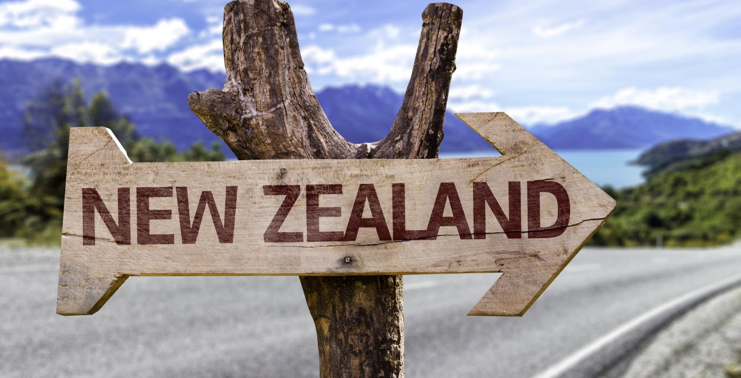
Mood of the Nation
New Zealanders' perceptions of international visitors
March 2020

Slide 2
Introduction
Mood of the Nation research is commissioned by Tourism Industry Aotearoa and Tourism New Zealand in November and March each year and measures New Zealanders’ perceptions of tourism. The research was conducted in March, prior to New Zealand’s nationwide lockdown measures and before the tourism sector impacted by Covid-19.
Top line results
92% of Kiwis agree that tourism is good for New Zealand
89% of Kiwis are proud that New Zealand remains an attractive destination
27% of Kiwis think that the current number of visitors is too high, with 49% agreeing the number is just right
34% of New Zealanders think that the government is taking action to address pressures of tourism growth
Pressure on infrastructure, damage to the environment and roads ill-equipped to handle volume were the top three concerns Kiwis have regarding international tourism
Economic growth for regions, employment benefits for residents and opportunities for businesses are the top three benefits Kiwis perceive regarding international tourism
Queenstown, Auckland and Rotorua were deemed to be the places under the most pressure from tourism
54% of Kiwis think that predicted international visitor growth was too much, with 46% agreeing that it was just right

Slide 3
Contents
1
Research approach | 4
2
Key insights | 6
3
Detailed insights | 10
4
Appendix: measures by region | 34

Slide 4
Research approach
1

Slide 5

Research approach
Method and audience
An online survey of residents in New Zealand aged 18 plus
Sample sizes
From Nov-18, the sample size for this study is approx. n = 1080* people, to ensure we provide robust insights at the reginal level. We set minimum quotas to ensure sufficient representation from traditional tourism hotspots.
*n = 500 sample used prior to November 2018
Fieldwork dates
Weighting
Respondents were weighted by gender, age and region to be representative of the New Zealand population based on 2017 population estimates
Northland | n = 100
Auckland region | n = 100
Rotorua | n = 50
Gisborne / Hawkes Bay | n = 100
Taranaki | n = 100
Manawatu-Whanganui | n = 80
Wellington region | n = 100
Other North Island | n = 20
Christchurch | n = 100
Elsewhere in Canterbury | n = 50
Queenstown | n = 100
Elsewhere in Otago | n = 50
West Coast | n = 100
Other South Island | n = 20
Wave 1: 2nd to 6th December, 2015 | Wave 5: 13th to 23rd November, 2017 | Wave 9: 4th to 27th November, 2019
Wave 2: 17th March to 2nd April, 2016 | Wave 6: 5th to 21st March, 2018 | Wave 10: 26th February to 10th March, 2020
Wave 3: 7th to 17th November, 2016 | Wave 7: 31st October to 13th November, 2018
Wave 4: 13th to 22nd March, 2017 | Wave 8: 26th February to 10th March 2019

Slide 6
Key insights
2

Slide 7
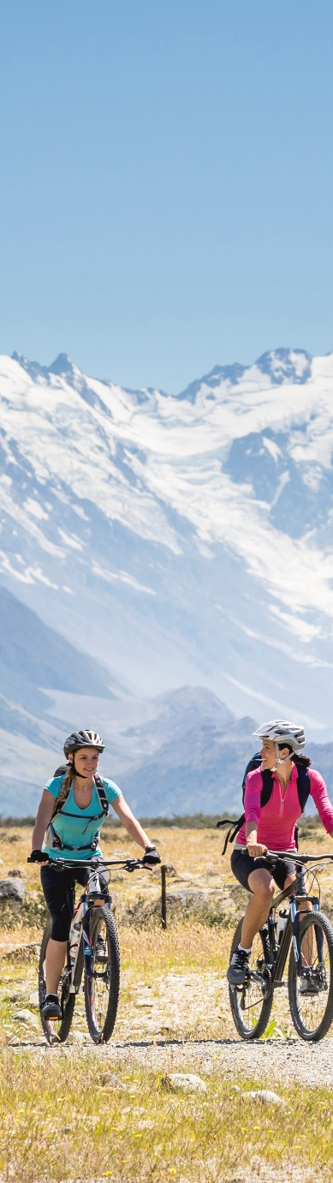
KEY INSIGHTS (page 1 of 3)
The vast majority of New Zealanders continue to agree that international tourism is good for New Zealand
Most people are generally proud of New Zealand being an attractive tourist destination and are welcoming of international visitors
Over the years the perception that New Zealand attracts too many tourists has been trending upwards, however this trend has stabilised in the last twelve months
About a half of New Zealanders continue to think that the number of current visitors is just right
IS INTERNATIONAL TOURISM GOOD FOR NEW ZEALAND?
92%
Strongly agree
or agree
46%
AGREE
47%
STRONGLYAGREE
March 2020
PERCEPTIONS THAT CURRENT NUMBER OF VISITORS IS TOO HIGH
Significantly higher / lower
than previous wave at 95%
7

Slide 8
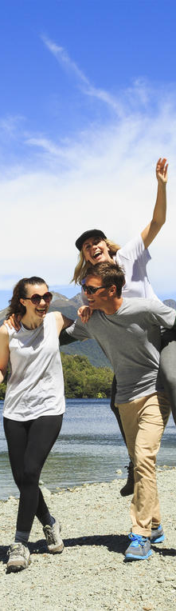
KEY INSIGHTS (page 2 of 3)
The percentage of New Zealanders who think that international tourism puts too much pressure on New Zealand has stabilised over the past three years, currently at 42%
This view is driven by perceptions of a lack of infrastructure to accommodate the growing number of international tourists and the damage tourism has on the environment
Otago residents are more likely to perceive there to be too much pressure from international visitors while Aucklanders are more likely to think New Zealand is well-equipped to handle it
Information in national media outlets and personal experience continue to have the most influence on the views New Zealanders have about international tourism
PERCEPTIONS THAT TOURISTS PUT TOO MUCH PRESSURE ON NEW ZEALAND
Pressure on infrastructure
Environmental damage
Roads ill-equipped
Top 5
ways tourism applies pressure
Disrespect (e.g. littering)
Scenic spots overcrowded
Significantly higher / lower
than previous wave at 95%
8

Slide 9
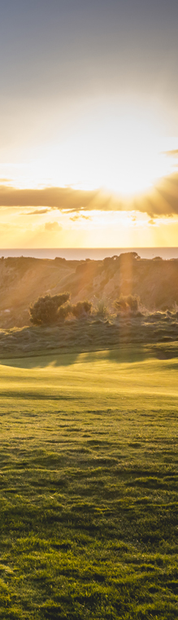
KEY INSIGHTS (page 3 of 3)
The proportion of New Zealanders that feel the predicted future growth of international visitors is too high remains stable compared to November and March last year
PERCEPTIONS OF PREDICTED GROWTH
Significantly higher / lower
than previous wave at 95%
9

Slide 10
Detailed insights
3

Slide 11
The vast majority of New Zealanders continue to agree that international tourism is good for New Zealand, with no change in this sentiment compared to a year ago
International tourism is good for New Zealand
% agree, 18+ year olds
Base: New Zealanders aged 18 plus: Mar-17 n = 500 | Nov-17 n = 501 | Mar-18 n = 555 | Nov-18 n = 1084 | Mar-19 n = 1083 | Nov-19 n = 1081 | Mar-20 n = 1089
Significantly higher / lower than previous wave at 95%

Slide 12
New Zealanders generally agree that they personally are open and welcoming of international tourists, however fewer agree that other New Zealanders feel the same way
Attitudes towards international visitors
% agree, 18+ year olds, Mar-20
Personal perceptions
Perceptions of how other New Zealanders feel
Base: New Zealanders aged 18 plus: Mar-20 n = 1089
Top two boxes significantly higher / lower than previous wave at 95%

Slide 13
Information in the national media outlets and personal experience continue to have the most influence on the views New Zealanders have about international tourism
What influences the opinions on international tourism
18+ year olds, Mar-20
Level of influence
1st most significant | 2nd most significant
46% | 15%
34% | 21%
10% | 34%
6% | 19%
4% | 11%
1
What I see / hear about tourism from national media outlets
2
What I experience first-hand in my daily life
3
What I hear from friends / family / colleagues that they experience first hand in their daily lives
4
What I see / hear about tourism from regional media outlets
5
What I see / hear about tourism from local media outlets
Base: New Zealanders aged 18 plus: Mar-20 n = 1089
Significantly higher / lower than previous wave at 95%

Slide 14
1 in 5 New Zealanders who know how many international visitors New Zealand attracts annually, an increase compared to November 2019, but similar Match 2019 and prior waves
Knowledge of annual visitor numbers
%, 18+ year olds
Actual number | 3m | 3.4m | 3.5m | 3.7m | 3.7m | 3.8m | 3.8m | 3.8m | 3.8m
Base: New Zealanders aged 18 plus: Mar-16 n = 520 | Nov-16 n = 521 | Mar-17 n = 500 | Nov-17 n = 501 | Mar-18 n = 555 | Nov-18 n = 1084 | Mar-19 n = 1083 | Nov-19 n = 1081 | Mar-20 n = 1089
Significantly higher / lower than previous wave at 95%

Slide 15
A quarter of New Zealanders know the number of people directly or indirectly employed in the tourism industry, a significant increase compared to November 2019
Knowledge of how many New Zealand workers employed in the tourism industry (directly or indirectly)
%, 18+ year olds
Correct answer | 1 in 8 | 1 in 8 | 1 in 8 | 1 in 8 | 1 in 8 | 1 in 8 | 1 in 8 | 1 in 8 | 1 in 8
Base: New Zealanders aged 18 plus: Mar-16 n = 520 | Nov-16 n = 521 | Mar-17 n = 500 | Nov-17 n = 501 | Mar-18 n = 555 | Nov-18 n = 1084 | Mar-19 n = 1083 | Nov-19 n = 1081 | Mar-20 n = 1089
Significantly higher / lower than previous wave at 95%

Slide 16
The majority of New Zealanders continue to think tourism is one of the top three revenue earners, while only 11% know that it is number one
Knowledge of the value of the tourism industry
%, 18+ year olds
Base: New Zealanders aged 18 plus: Nov-17 n = 501 | Mar-18 n = 555 | Nov-18 n = 1084 | Mar-19 n = 1083 | Nov-19 n = 1081 | Mar-20 n = 1089
Significantly higher / lower than previous wave at 95%

Slide 17
There has been a seasonal uplift in the proportion of New Zealanders who think New Zealand attracts too many international visitors – the current levels are in line with March last year
Perceptions of whether New Zealand attracts too few/too many international visitors
%, 18+ year olds
Based on perceived number of current visitors
Base: New Zealanders aged 18 plus: Mar-16 n = 520 | Nov-16 n = 521 | Mar-17 n = 500 | Nov-17 n = 501 | Mar-18 n = 555 | Nov-18 n = 1084 | Mar-19 n = 1083 | Nov-19 n = 1081 | Nov-19 n = 1089
Significantly higher / lower than previous wave at 95%

Slide 18
The perception of international visitor volumes remains stable, with half of New Zealanders agreeing that it is just right
Perceptions of whether New Zealand attracts too few/too many international visitors
%, 18+ year olds
Based on actual number of current visitors
Base: New Zealanders aged 18 plus: Mar-16 n = 520 | Nov-16 n = 521 | Mar-17 n = 500 | Nov-17 n = 501 | Mar-18 n = 555 | Nov-18 n = 1084 | Mar-19 n = 1083 | Nov-19 n = 1081 | Nov-19 n = 1089
Significantly higher / lower than previous wave at 95%

Slide 19
Top reasons for New Zealanders thinking that there are too many international visitors include a lack of adequate infrastructure, environmental damage and overcrowding
”
Themed verbatim reasons for there being too many international visitors (27%)
Lack of infrastructure
Environmental damage
Overcrowding
“We do not have the infrastructure at a lot of tourism areas”
“The burden which some tourists can place on our infrastructure is negative as they do not have to pay for the upkeep of the roads, water, upkeep of smaller DOC walking tracks, etc”
“New Zealand has poor infrastructure even for its own residents. Allowing tourists in at the ridiculous numbers they are coming only exacerbates already existing problems”
“The industry is placing a strain on local infrastructure to the detriment of locals on some areas. Growth needs to slow down to allow”
“I welcome international visitors and hope they have an enjoyable visit, but to be honest I don't think there is enough infrastructure to cope with the high demands of international visitors, infrastructure needs to catch up”
“It's getting to the point that there are too many of them and our environment is being wrecked”
“I think that we need to ensure that we weigh up the impact of too many people trampling over native areas of NZ that need to be taken care of environmentally. Freedom campers can sometimes leave rubbish behind. People need to respect our natural environment when they come to these shores, most do but unfortunately there are those who do not”
“We have not got the infrastructure in place yet to make sure our native environments are safe – tourism is eroding our natural environments”
“Too many tourists come to New Zealand and mistreat our forests, beaches and mountains. Our country is SMALL – we are not big enough or environmentally stable enough to hold the amount of people living here currently let alone tourists. We are NOT a big country. We need to cater for the amount this country can handle”
“Because it is sometimes very hard for the average joe blog kiwi to enjoy New Zealand as there are too many tourists around”
“Locations lose the attractiveness due to too many tourists at one time ie Queenstown...Tongariro Crossing”
“I think we risk killing the goose with the golden egg if we over do it. Too many tourists and their experience will suffer and we will also diminish our desirability as a tourist destination”
“Too many tourists spoil NZ for NZers”
“Tourist spots are too crowded, we don't have the infrastructure to support, they don't respect our country”
“Tourist spots are getting more over-crowded than I would like when I am seeing New Zealand”
“Overcrowding at tourist spots and on the roads”
Base: n = 1089

Slide 20
Economic benefits and job creation and that there is still enough capacity to accommodate more visitors remain the top reasons why some New Zealanders feel there are too few international visitors
”
Themed verbatim reasons for there being too few international visitors (18%)
Economic benefits and job creation
Managed expansion
“Always room to improve and bring in more tourism revenue”
“We are an Island nation with relative isolation. We need tourists to boost our economy and hopefully continue to do so when they return home and talk with their friends about us”
“More tourism means more jobs and dollars for our country”
“More tourist would mean more jobs for kiwis and we still have unemployed”
“Showcase NZ, provide opportunities and jobs, making outward travel cheaper because of increased flights”
“We need more to come to create jobs for New Zealanders”
“We need more to stimulate the economy”
“I am not the most informed on the subject; I think Tourism is good for the economy but I hope the economic benefits would affect everyone and not just a few”
“The economy relies on international tourism; There are enough opportunities still to welcome more tourists”
“New Zealand has natural beauties that attract many tourists, however if the government put more attention in welcoming tourists and more activities, there would be a higher number of tourists therefore a faster growing economy in the tourism industry”
“There is always room and opportunity to encourage more tourists to visit New Zealand. Especially to areas such as Taranaki, Gisborne and Hawkes Bay”
“I think there is a lot more room for more visitors”
“I think there's definitely room for more”
“Based on the capacity of the country, we can make more money from this industry”
“We can handle more”
“Can handle more, especially cruise liner tourists”
“I feel we can handle more now with care and with additional planning thought and attractions can handle more”
“We can do better”
“We could always do with more”
“I think NZ has to attract more travellers from other countries, not only the same”
“There might be an infrastructure issue regarding accommodation for tourist, however, I do believe that the demand is so high that we will resolve the issue and get more tourists to NZ”
Base: n = 1089

Slide 21
The proportion of New Zealanders who think the current number of international tourists puts too much pressure on New Zealand has been relatively stable over the last year, currently at 42%
Perceptions that tourists put too much pressure on New Zealand
%, 18+ year olds
Base: New Zealanders aged 18 plus: Dec-15 n = 502 | Mar-16 n = 520 | Nov-16 n = 521 | Mar-17 n = 500 | Nov-17 n = 501 | Mar-18 n = 555 | Nov-18 n = 1084 | Mar-19 n = 1083 | Nov-19 n = 1081 | Nov-19 n = 1089
Significantly higher / lower than previous wave at 95%

Slide 22
Pressure on infrastructure continues to be the top concern New Zealanders have with international tourism, while concerns around ill-equipped roads have increased significantly compared to November 2019
Perceptions of how tourism puts pressure on New Zealand
%, those who say “too much pressure”, Mar-20
Nov-19 | Mar-19 | Nov-18
39% | 44% | 44%
22% | 20% | 19%
9%
12% | 10% | 11%
11% | 11% | 10%
12% | 16% | 22%
13% | 25% | 14%
7% | 11% | 9%
13% | 10% | 6%
9% | 10% | 12%
Nov-19: 9%, ranked 9th
Base: Those who say “too much pressure”: Nov-18 n = 449 | Mar-19 n = 472 | Nov-19 n = 457 | Mar-20 n = 503
Notes: Based on unprompted verbatim
Significantly higher / lower than previous wave at 95%

Slide 23
The proportion of New Zealanders who believe that some places are under more pressure than others has remained unchanged over the past year, currently at 37%
“Some places are under more pressure”
% agree, 18+ year olds
Base: New Zealanders aged 18 plus: Dec-15 n = 502 | Mar-16 n = 520 | Nov-16 n = 521 | Mar-17 n = 500 | Nov-17 n = 501 | Mar-18 n = 555 | Nov-18 n = 1084 | Mar-19 n = 1083 | Nov-19 n = 1081 | Nov-19 n = 1089
Significantly higher / lower than previous wave at 95%

Slide 24
Queenstown and Auckland continue to be the main places perceived to be under the most pressure; perceptions of pressure on Rotorua in particular have increased compared to November last year, but similar to March last year
Which places? – top 10
%, Mar-20, those who say some places are under more pressure
Base: Say some places are under more pressure: Nov-18 n = 402 | Mar-19 n = 436 | Nov-19 n = 436 | Mar-20 n = 442
Significantly higher / lower than previous wave at 95%

Slide 25
The proportion of New Zealanders that feel the predicted future growth of international visitors is too high remains stable over the past year
Attitudes towards predicted future growth of annual international visitors
%, 18+ year olds
Predicted growth | 4m in 4-5 yrs | 4m in 4-5 yrs | 4m in 2-3 yrs | 4m in 2-3 yrs | 4.5m in 4-5 yrs | 4.5m in 4-5 yrs | 5m in 4-5 yrs | 5m in 4-5 yrs | 5m in 4-5 yrs | 5m in 4-5 yrs
Base: New Zealanders aged 18 plus: Mar-16 n = 520 | Nov-16 n = 521 | Mar-17 n = 500 | Nov-17 n = 501 | Mar-18 n = 555 | Nov-18 n = 1084 | Mar-19 n = 1083 | Nov-19 n = 1081 | Nov-19 n = 1089
Significantly higher / lower than previous wave at 95%

Slide 26
A lack of adequate infrastructure, poor experiences for locals and environmental damage are the key reasons why New Zealanders feel the predicted growth is too much
”
Themed verbatim reasons for there being too much predicted growth (54%)
Lack of infrastructure
Poor experience for NZers
Environmental damage
“I think a large draw card for NZ is that there aren’t too many people at tourist hot spots. Our infrastructure in places isn’t keeping up with the increase in permanent population let alone temporary”
“Because the infrastructure to accommodate them will cost a fortune and it's time to look after our own people first. Spend the money making people work for their benefits if they're between 17 and 25 instead of making the rich richer”
“I doubt we will have got our act together, on facilities and infrastructure needed and will be still discussing who is going to pay for and do it!”
“Increasing it 20% puts extra strain on infrastructure and amenities - they're already bleating about Auckland's water so why would you put further strain on that?”
“Current and future infrastructure is unlikely to be able to cope with such an increase in tourism”
“Need to focus on ourselves first”
“Tourists bring their own negative influences to a country, even if it's only a small percentage of tourists that do this; eg drug, violence, law and order; This needs to be balanced against the positive influences of the effects on our economy – overseas income, employment, infrastructure growth. I feel that we mustn't let the love of money override our domestic lifestyles so a balance needs to be found”
“We will become more and more stretched in our services, which will result in a reliance on tourism for New Zealand to progress and in jobs. We need to ensure that we can operate without tourism and still have a healthy country”
“We have a lot of poverty and issues within our own country that I feel need to be made a priority first”
“Too many locals suffering from inability to live in tourist areas”
“The tourist burden only exacerbates the problem of excess and irresponsible use of fossil fuels and other resources and contributes significantly to climate change without significant benefits. Oh, except to make money for the already wealthy in NZ”
“Some areas of our environment are getting visitor overload already so we need to be cautious of continually increasing the numbers. Making money is great but we should always be aware of sustainability”
“I am concerned that such a rapid increase in tourists would create an environmental impact on us if not properly addressed”
“The environment will suffer for it”
“A lot of people who come do not care about our ‘clean, green’ environment especially freedom campers and more of this type of tourists would result in our tourist spots becoming rubbish tips”
Base: n = 1089

Slide 27
Economic growth and perceptions that we have capacity to accommodate more visitors if the growth is well managed are the main reasons why New Zealanders think the predicted growth is not enough; this view is consistent with previous waves
”
Themed verbatim reasons for there being not enough predicted growth (5%)
Economic growth
Managed capacity
“Tourists increase our economy”
“We need more to help the economy”
“Good for economy; Need to develop infrastructure better for them though”
“More visitors grow the local economy”
“Job opportunities”
“More tourism more jobs created!”
“Helps our country grow”
“More tourists equals more dollars for NZ business”
“Need to target growth not reduction”
“We are a small country with small population so more visitors spending money better for us”
“Drives growth in smaller areas”
“Tourists increase our economy”
“Good for economy”
“More income”
“Still room for improvement”
“There are still areas that need re-addressing to be able to handle that amount of tourism”
“The answer is dependent on our ability to develop the infrastructure required to successfully cater for more tourists”
“We need all the resources to help to lift up our economy to a better level”
“Need to develop infrastructure better for them though”
“NZ had better get organised to welcome all these visitors”
“Growth is important and good for all, but ONLY if we can keep up with infrastructure. Roads, parks, toilets, rest areas, eateries, motels (as in number of beds available) all need to grow with it”
“We've got plenty of space and resources to handle it... just use other countries’ models”
“NZ has the space to accommodate more tourists. They are not going to be congregating in one key area, they are generally going to be spread over the entire NZ”
“NZ can accommodate much more, earn more and grow more from tourism”
Base: n = 1089

Slide 28
Key perceived benefits of tourism are economic growth for the regions and businesses as well as employment opportunities; economic growth as a predicted benefit shows a significant increase from previous waves
Pros of international tourism
% agree, 18+ year olds, Mar-20
Creates economic growth for the regions
Creates employment opportunities for residents
Creates growth opportunities for businesses
Adds to the vitality of regions and local communities
Connects local communities to other cultures
Drives improvements to recreational facilities in local communities
Drives infrastructure development in the regions
Base: New Zealanders aged 18 plus: Nov-18 n = 1084 | Mar-19 n = 1083 | Nov-19 n = 1081 | Mar-20 n = 1089
Notes: Agreement on a 7 point scale where 1 is ‘strongly disagree’ and 7 is ‘strongly agree’; Top two box is shown
Significantly higher / lower than previous wave at 95%

Slide 29
Perceptions of the adverse impacts of tourism see a significant increase in traffic congestion and road accidents, other top concerns include risk of serious road accidents and increased littering
Cons of international tourism
% agree, 18+ year olds, Mar-20
Results in increased traffic congestion on holiday routes
Results in a higher number of road accidents
Increases the risk of serious road accidents
Results in increased littering
Results in damage to New Zealand’s natural environment
Makes accommodation too expensive for New Zealand residents
Makes it hard for New Zealanders to find accommodation vacancies
Means attractions are too busy for New Zealand residents to enjoy
Increases congestion in the walking areas of urban centers
Makes it hard to find enough staff to work in the tourism industry
Base: New Zealanders aged 18 plus: Nov-17 n = 501 | Mar-18 n = 555 | Nov-18 n = 1084 | Mar-19 n = 1083 | Nov-19 n = 1081 | Mar-20 n = 1089
Notes: Agreement on a 7 point scale where 1 is ‘strongly disagree’ and 7 is ‘strongly agree’; Top two box is shown
Significantly higher / lower than previous wave at 95%

Slide 30
The strength of perceived benefits of international tourism varies by region, with residents of Auckland, Wellington and Manawatu-Whanganui regions having the strongest perceptions of benefits from tourism
Pros of international tourism by region
% agree, 18+ year olds, Mar-20
 | Northland | Auckland | Bay of Plenty | Gisborne /Hawkes Bay | Taranaki | Manawatu-Whanganui | Wellington | Canterbury | Otago* | West Coast
Creates economic growth for the regions
Creates employment opportunities for residents
Creates growth opportunities for businesses
Adds to the vitality of regions and local communities
Connects local communities to other cultures
Drives improvements to recreational facilities in local communities
Drives infrastructure development in the regions
Base n =
56% | 66% | 55% | 55% | 45% | 57% | 60% | 60% | 63% | 52%
49% | 59% | 60% | 50% | 46% | 65% | 55% | 49% | 57% | 49%
52% | 56% | 52% | 52% | 56% | 61% | 56% | 55% | 58% | 50%
45% | 39% | 35% | 37% | 41% | 46% | 42% | 41% | 35% | 35%
39% | 39% | 24% | 41% | 32% | 37% | 34% | 31% | 28% | 35%
29% | 33% | 24% | 28% | 26% | 27% | 34% | 39% | 21% | 31%
36% | 27% | 29% | 31% | 18% | 23% | 25% | 28% | 26% | 30%
100 | 101 | 60 | 102 | 100 | 80 | 103 | 151 | 153 | 99
Heat map shading is across rows
Relative agreement
Weaker
Stronger
Notes: Agreement on a 7 point scale where 1 is ‘strongly disagree’ and 7 is ‘strongly agree’; Top two box is shown
* Broken down by Queenstown and rest of Otago in appendix

Slide 31
Perceptions of negative impacts of tourism are strongest among those residing in Otago and the West Coast
Cons of international tourism by region
% agree, 18+ year olds, Mar-20
 | Northland | Auckland | Bay of Plenty | Gisborne /Hawkes Bay | Taranaki | Manawatu-Whanganui | Wellington | Canterbury | Otago* | West Coast
Results in increased traffic congestion on holiday routes
Results in a higher number of road accidents
Increases the risk of serious road accidents
Results in increased littering
Results in damage to New Zealand’s natural environment
Makes accommodation too expensive for New Zealand residents
Makes it hard for New Zealand residents to find accommodation vacancies
Means attractions are too busy for New Zealand residents to enjoy
Increases congestion in the walking areas of urban centres
Makes it hard to find enough staff to work in the tourism industry
Base n =
51% | 51% | 47% | 53% | 44% | 53% | 40% | 48% | 65% | 63%
42% | 37% | 46% | 38% | 36% | 57% | 38% | 47% | 60% | 57%
43% | 38% | 53% | 42% | 43% | 46% | 35% | 48% | 60% | 56%
38% | 45% | 33% | 39% | 33% | 46% | 29% | 46% | 50% | 56%
38% | 39% | 41% | 42% | 26% | 41% | 32% | 41% | 45% | 40%
32% | 33% | 37% | 41% | 32% | 39% | 26% | 37% | 54% | 44%
28% | 27% | 27% | 36% | 28% | 32% | 21% | 29% | 42% | 38%
19% | 32% | 25% | 32% | 25% | 39% | 19% | 24% | 36% | 32%
30% | 27% | 21% | 29% | 22% | 22% | 17% | 23% | 44% | 31%
23% | 15% | 15% | 14% | 14% | 12% | 11% | 21% | 39% | 24%
100 | 101 | 60 | 102 | 100 | 80 | 103 | 151 | 153 | 99
Relative agreement
Weaker
Stronger
Notes: Agreement on a 7 point scale where 1 is ‘strongly disagree’ and 7 is ‘strongly agree’; Top two box is shown
* Broken down by Queenstown and rest of Otago in appendix

Slide 32
The proportion of New Zealanders who agree that action is being taken by government and industry to address the pressures of tourism growth has plateaued compared to previous waves
Agreement that action is being taken to address the pressures of tourism growth
% 18+ year olds, Mar-20
Base: New Zealanders aged 18 plus: Nov-18 n = 1084 | Mar-19 n = 1083 | Nov-19 n = 1081 | Mar-20 n = 1089
Significantly higher / lower than previous wave at 95%

Slide 33

The vast majority of New Zealanders continue to believe that the initiatives such as Tiaki are important in helping visitors travel safely and conscientiously in New Zealand
Believe that an initiatives such as Tiaki are important
% 18+ year olds, Mar-20
Base: New Zealanders aged 18 plus: Mar-19 n = 1083 | Nov-19 n = 1081 | Mar-20 n = 1089
Significantly higher / lower than previous wave at 95%

Slide 34
Appendix: measures by region
4

Slide 35
Wellington and Otago residents are more likely to overestimate annual visitor numbers
Knowledge of annual visitor numbers – by region
%, Mar-20
Base: Total NZ n = 1089 | Northland n = 100 | Auckland n = 101 | Bay of plenty n = 60 | Gisborne/Hawkes Bay n = 102 | Taranaki n = 100 |
Manawatu-Whanganui n = 80 | Wellington n = 103 | Canterbury n = 151 | Otago n = 153 | West Coast n = 99
Significantly higher / lower than all other New Zealand regions at 95%

Slide 36
Otago and West Coast residents are more likely to overestimate the number of New Zealand workers employed in the tourism industry
Knowledge of New Zealand workers employed in the tourism industry – by region
%, Mar-20
Correct answer: 1 in 8
Base: Total NZ n = 1089 | Northland n = 100 | Auckland n = 101 | Bay of plenty n = 60 | Gisborne/Hawkes Bay n = 102 | Taranaki n = 100 |
Manawatu-Whanganui n = 80 | Wellington n = 103 | Canterbury n = 151 | Otago n = 153 | West Coast n = 99
Significantly higher / lower than all other New Zealand regions at 95%

Slide 37
Bay of Plenty and Otago residents are more likely to know that tourism is New Zealand's number 1 export, whilst Aucklanders tend to underestimate the value of tourism
Knowledge of the value of the tourism industry – by region
%, Mar-20
(New Zealand’s number one
export industry)
Base: Total NZ n = 1089 | Northland n = 100 | Auckland n = 101 | Bay of plenty n = 60 | Gisborne/Hawkes Bay n = 102 | Taranaki n = 100 |
Manawatu-Whanganui n = 80 | Wellington n = 103 | Canterbury n = 151 | Otago n = 153 | West Coast n = 99
Significantly higher / lower than all other New Zealand regions at 95%

Slide 38
Again, Otago residents are more likely to perceive there to be too many international visitors
Perception of current number of international visitors (based on actual number) – by region
%, Mar-20
Base: Total NZ n = 1089 | Northland n = 100 | Auckland n = 101 | Bay of plenty n = 60 | Gisborne/Hawkes Bay n = 102 | Taranaki n = 100 |
Manawatu-Whanganui n = 80 | Wellington n = 103 | Canterbury n = 151 | Otago n = 153 | West Coast n = 99
Significantly higher / lower than all other New Zealand regions at 95%

Slide 39
Unsurprisingly, residents of Otago are more likely to perceive there to be too much pressure from international visitors while Auckland residents are more likely to think New Zealand is well-equipped to handle it
Perceptions of the pressure that tourists put on New Zealand – by region
%, Mar-20
Base: Total NZ n = 1089 | Northland n = 100 | Auckland n = 101 | Bay of plenty n = 60 | Gisborne/Hawkes Bay n = 102 | Taranaki n = 100 |
Manawatu-Whanganui n = 80 | Wellington n = 103 | Canterbury n = 151 | Otago n = 153 | West Coast n = 99
Significantly higher / lower than all other New Zealand regions at 95%

Slide 40
Bay of Plenty and Otago residents are more likely to believe that the predicted growth is too much
Attitudes towards predicted future growth of annual international visitors – by region
%, Mar-20
Significantly higher / lower than all other New Zealand regions at 95%
Base: Total NZ n = 1089 | Northland n = 100 | Auckland n = 101 | Bay of plenty n = 60 | Gisborne/Hawkes Bay n = 102 | Taranaki n = 100 |
Manawatu-Whanganui n = 80 | Wellington n = 103 | Canterbury n = 151 | Otago n = 153 | West Coast n = 99
Significantly higher / lower than other New Zealand at 95%

Slide 41
Gisborne/Hawkes Bay residents have the lowest level of agreement that action is being taken to address the pressures of tourism growth
Agreement that action is being taken to address the pressures of tourism growth
% 18+ year olds, Mar-20
Base: Total NZ n = 1089 | Northland n = 100 | Auckland n = 101 | Bay of plenty n = 60 | Gisborne/Hawkes Bay n = 102 | Taranaki n = 100 |
Manawatu-Whanganui n = 80 | Wellington n = 103 | Canterbury n = 151 | Otago n = 153 | West Coast n = 99
Significantly higher / lower than all other New Zealand regions at 95%

Slide 42
Queenstown residents are more likely to think there is too much pressure from international visitors compared to the rest of Otago
Perceptions of the pressure that international tourists put on New Zealand – Otago region
%, Mar-20
Base: Total NZ n = 1089 | Queenstown n = 102 | Rest of Otago n = 51
Queenstown significantly higher / lower than rest of Otago at 95%

Slide 43
Queenstown residents’ opinions on the positive impacts of international tourism on the country are similar to those from rest of Otago
Pros of international tourism – Otago region
% agree, 18+ year olds, Mar-20
 | Total New Zealand |  | Queenstown | Rest of Otago
Creates economic growth for the regions | 62% |  | 61% | 65%
Creates employment opportunities for residents | 58% |  | 56% | 59%
Creates growth opportunities for businesses | 57% |  | 58% | 59%
Adds to the vitality of regions and local communities | 41% |  | 34% | 38%
Connects local communities to other cultures | 36% |  | 28% | 28%
Drives improvements to recreational facilities in local communities | 32% |  | 17% | 30%
Drives infrastructure development in the regions | 28% |  | 26% | 28%
Base n = | 1089 |  | 102 | 51
Queenstown significantly higher / lower than rest of Otago at 95%
Notes: Agreement on a 7 point scale where 1 is ‘strongly disagree’ and 7 is ‘strongly agree’; Top two box is shown

Slide 44
Residents of Queenstown are significantly more likely to perceive negative impacts of tourism on the risk of serious road accidents and increased littering, compared to the rest of Otago
Cons of international tourism – Otago region
% agree, 18+ year olds, Mar-20
 | Total New Zealand |  | Queenstown | Rest of Otago
Results in increased traffic congestion on holiday routes | 52% |  | 69% | 55%
Results in a higher number of road accidents | 44% |  | 65% | 49%
Increases the risk of serious road accidents | 44% |  | 66% | 48%
Results in increased littering | 43% |  | 57% | 34%
Results in damage to New Zealand’s natural environment | 40% |  | 49% | 36%
Makes accommodation too expensive for New Zealand residents | 35% |  | 52% | 56%
Makes it hard for New Zealand residents to find accommodation vacancies | 29% |  | 41% | 45%
Means attractions are too busy for New Zealand residents to enjoy | 29% |  | 38% | 32%
Increases congestion in the walking areas of urban centres | 26% |  | 48% | 36%
Makes it hard to find enough staff to work in the tourism industry | 18% |  | 41% | 33%
Base n = | 1089 |  | 102 | 51
Queenstown significantly higher / lower than rest of Otago at 95%
Notes: Agreement on a 7 point scale where 1 is ‘strongly disagree’ and 7 is ‘strongly agree’; Top two box is shown

