Slide 1
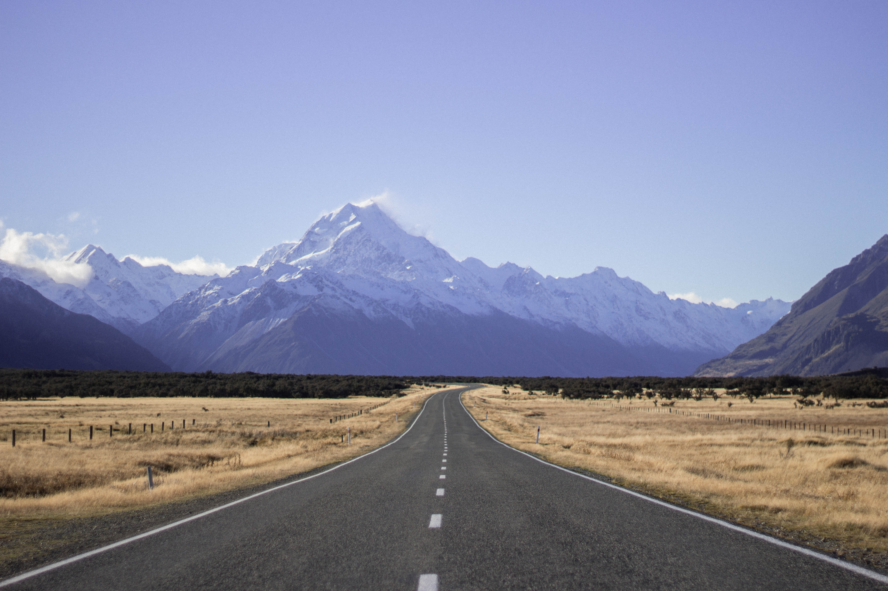


DOMESTIC visitor SATISFACTION
UPDATE: YEAR ENDING MARCH 2022

Slide 2
DOMESTIC VISITOR SATISFACTION (YE MARCH 2022)
Key insights
This report provides an overview of New Zealanders’ most recent domestic leisure trip (taken during the 12 months prior to completion). The data presents an aggregate view from surveys completed between April 2021 and March 2022 (meaning that the trip reported on may have taken place as far back as April 2020 or as recently as March 2022). Below are key insights for the survey year ending March 2022, in comparison with the year ending March 2021.
Incidence of travel and reason for travel: Three in four New Zealanders took a domestic leisure trip during the survey period. While this proportion has been relatively stable over time, reason for travel has changed recently – a higher proportion of New Zealanders are travelling for holidays/short-breaks, and a lower proportion are travelling to attend public and private events. This likely reflects the impact of the COVID-19 pandemic on the number and type of events staged during the survey period, as well as the decreased ability of New Zealanders to holiday overseas.
Length of trip: There is no significant change over time in the length of trips undertaken. The median length of domestic leisure trips is three nights.
Destination market share: Auckland has experienced a decline in market share of domestic overnight leisure trips. Several factors are likely to have influenced this change such as a higher proportion of Aucklanders than usual visiting other regions, lockdowns specific to Auckland, and fewer event trips occurring. Queenstown has gained market share over the same period.
Satisfaction: A slight decrease in overall satisfaction levels is evident - 57% scored their satisfaction as 9 or 10 out of 10 in the most recent year compared to 63% in the previous year. Older New Zealanders continue to be more satisfied than younger New Zealanders, as do those taking longer trips.
Experience vs Expectation: Half of New Zealanders had their expectations exceeded on their most recent domestic overnight leisure trip, and a similar proportion found it just as they expected. Only a very small proportion found it worse than expected.
Net Promotor Score: NPS is used to measure an individual’s propensity to recommend New Zealand as a holiday destination for other New Zealanders. NPS has fallen again compared with the previous year, from +64 to +55. The change in NPS is being driven by a lower proportion of ‘promoters’ and a slight increase in the proportion of ‘detractors’. Like satisfaction, NPS is lower for younger New Zealanders and higher for older New Zealanders.

Slide 3
DOMESTIC VISITOR SATISFACTION (YE MARCH 2022)
PROFILE OF LAST DOMESTIC OVERNIGHT LEISURE TRIP
3 in 4 New Zealand residents travelled domestically for leisure in the past 12 months
MAIN REASON FOR TRIP
 | YE Mar 2021 | YE Mar 2022
Length of Trip:
1 Night | 13% | 13%
2 Nights | 24% | 26%
3 Nights | 19% | 20%
4 Nights | 11% | 10%
5 Nights | 10% | 8%
6 Nights | 3% | 4%
7 Nights (or more) | 19% | 19%
Average Number of Nights (Median) | 3 | 3
Base: Total Sample | n=2,187 | n=2,273
YE Mar
2021
YE Mar
2022
 | For a holiday or short-break
 | To visit family or friends
 | To attend an event held by friends or family (e.g., wedding, funeral, or reunion)
 | To attend an event held by someone else (e.g., a sporting event, concert or festival)
 | Other
Base: NZ residents who travelled domestically for leisure during the 12 months prior to survey completion (n=2,273)

Slide 4
DOMESTIC VISITOR SATISFACTION (YE MARCH 2022)
PROFILE OF LAST DOMESTIC OVERNIGHT LEISURE TRIP
Which region/s did you visit on your last overnight trip within New Zealand?
What time of year was your last overnight trip within New Zealand?
 | YE Mar 2021 | YE Mar 2022
Regions Visited (Top 15):
Auckland | 22% | 19%
Wellington | 13% | 13%
Hamilton/Waikato | 11% | 12%
Rotorua | 11% | 12%
Northland | 11% | 11%
Taupō | 11% | 11%
Bay of Plenty (excl. Rotorua) | 11% | 11%
Christchurch | 11% | 11%
Queenstown | 8% | 10%
The Coromandel | 7% | 8%
Canterbury (excl. Christchurch) | 10% | 8%
Hawke’s Bay | 8% | 7%
Palmerston North & Manawatū | 7% | 6%
Dunedin | 6% | 5%
Taranaki | 5% | 5%
Base: Total Sample | n=2,187 | n=2,273
 | YE Mar 2021 | YE Mar 2022
Time of Year:
January | 20% | 17%
February | 16% | 12%
March | 8% | 11%
April | 3% | 12%
May | 5% | 9%
June | 8% | 10%
July | 9% | 10%
August | 7% | 6%
September | 9% | 5%
October | 11% | 6%
November | 10% | 6%
December | 12% | 10%
Base: Total Sample | n=2,187 | n=2,273
Base: NZ residents who travelled domestically for leisure during the 12 months prior to survey completion (n=2,273)

Slide 5
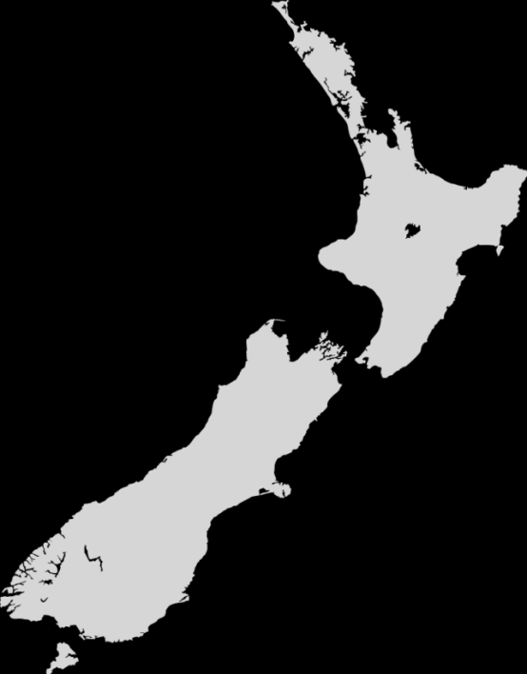
DOMESTIC VISITOR SATISFACTION (YE MARCH 2022)
OVERALL satisfaction
On a scale of 1 (not at all satisfied) to 10 (extremely satisfied), how satisfied were you with your overall experience on your last overnight trip within New Zealand?
Not at all
satisfied
Extremely
satisfied
 | Average | (1) | (2) | (3) | (4) | (5) | (6) | (7) | (8) | (9) | (10)
Year Ending March 2021 | 8.7 | 0% | 0% | 0% | 0% | 2% | 4% | 10% | 21% | 26% | 37%
Year Ending March 2022 | 8.6 | 0% | 0% | 0% | 0% | 2% | 5% | 10% | 25% | 23% | 34%
SATISFACTION BY AGE
SATISFACTION BY LENGTH OF TRIP
Average
Average
8.2
8.3
8.5
8.7
9.1
9.0
8.3
8.5
8.6
8.7
8.5
9.0
8.8
Base: NZ residents who travelled domestically for leisure during the 12 months prior to survey completion (n=2,273)

Slide 6

DOMESTIC VISITOR SATISFACTION (YE MARCH 2022)
OVERALL satisfaction
On a scale of 1 (not at all satisfied) to 10 (extremely satisfied), how satisfied were you with your overall experience on your last overnight trip within New Zealand?
SATISFACTION BY MONTH OF TRIP
SATISFACTION BY REGION VISITED *
Average
Average
8.6
8.6
8.8
8.6
8.8
8.7
8.5
8.3
8.6
8.5
8.8
8.4
8.5
8.5
8.5
8.6
8.9
8.6
8.8
8.7
8.7
8.7
8.7
8.7
8.8
8.5
8.8
* Results for the 15 most commonly visited regions are displayed
Base: NZ residents who travelled domestically for leisure during the 12 months prior to survey completion (n=2,273)

Slide 7
DOMESTIC VISITOR SATISFACTION (YE MARCH 2022)
Experience vs. Expectation
Based on your previous travel, how did your overall experience on your most recent trip live up to your expectations?
48% of New Zealanders had their expectations exceeded on their most recent domestic overnight leisure trip
 | Much better than I expected
 | Better than I expected
 | Just as I expected
 | Worse than I expected
 | Much worse than I expected
EXPERIENCE VS. EXPECTATION BY AGE
Expectations
Exceeded
55%
49%
53%
45%
45%
38%
YE Mar 2021
YE Mar 2022
Base: NZ residents who travelled domestically for leisure during the 12 months prior to survey completion (n=2,273)

Slide 8


DOMESTIC VISITOR SATISFACTION (YE MARCH 2022)
COMMENTS (Q1 2022)
For what reason/s did you rate your overall experience in that way?
“As everything was safe and secure after Covid”
“The weather was beautiful and the market in Wellington was awesome”
“Beautiful scenery, excellent weather. Nice to get away with the family after a year of Covid”
“I expected because of Covid for things to feel strange and restrictive, apart from wearing masks on public transport it was almost normal”
“Me and my son enjoyed a lot in Hawkes bay, beautiful place, we enjoyed the beach, the food, we did hiking, and the scenery, we will definitely will come back there.”
“Always love trips to Tauranga - a lovely place and lots to do”
“Hastings is a nice city that I enjoyed visiting.”
“Rotorua is that classic spot you go to once in a while if you live in the North Island, for the convenience. It's got the thrills you want and the relaxation activities sought after.”
“I was concerned of the health issues of Covid on the bus and ferry, but it turned out to be relaxing experiences.”
“Less foreign tourists creating havoc on the roads made for very pleasant driving”
“Felt very welcomed by residents and businesses around New Zealand, enjoyed beautiful scenery, great health spa therapies, fantastic dining and shopping, wonderful art galleries and museums”
“Due to never been in Christchurch, I found this city was so peaceful, beautiful and its lands and roads almost were flat. I really like this city.”
“The price of activities/food/drinks in New Zealand is far too expensive for the average New Zealander”
“My issue was with Air NZ who changed my flight with very short notice which ruined a whole day or plans”
“Traffic and hard parking in Auckland”
“Accommodation was not what was advertised and car hire company was inefficient.”
“Didn't get to go to Hamilton due to lockdown, but still got most of my trip in Tauranga. Terrible weather, there's not a lot to do in Tauranga if the weather is poor.”
“Some services shut down due to Covid”
“Outing in New Zealand is very expensive i.e. hotels, food, tickets etc.”
“Everything is over priced in Queenstown and Wanaka”

Slide 9

DOMESTIC VISITOR SATISFACTION (YE MARCH 2022)
NET PROMOTER SCORE (NPS)
On a scale of 0 (not at all likely) to 10 (extremely likely), how likely are you to recommend New Zealand as a holiday destination for New Zealanders?
The Net Promoter Score (NPS) is an indicator used globally to measure customer engagement and advocacy, based on the likelihood of a customer to recommend your product or service. Any positive score means that you have more loyal advocates willing to recommend your product or service (promoters) than unhappy critics (detractors). A passive customer is satisfied, but unenthusiastic. A high score of +100 means that every customer is a promoter, while a low score of -100 means that every customer is a detractor.
Detractors
Passives
Promoters
NPS BY AGE
0 | 1 | 2 | 3 | 4 | 5 | 6 | 7 | 8 | 9 | 10
18-29 years + 41
30-39 years + 50
40-49 years + 49
50-59 years + 57
60-69 years + 76
70 years+ + 76
0%
0%
0%
1%
0%
4%
4%
9%
18%
17%
47%
64%
Promoters
9%
Detractors
+ 55
NPS
There has been a significant decrease in the Net Promoter Score over the past two years
YE Mar 2021: NPS + 64
72% Promoters – 8% Detractors
YE Mar 2020: NPS + 66
73% Promoters – 7% Detractors
minus
=
Base: NZ residents who travelled domestically for leisure during the 12 months prior to survey completion (n=2,273)

Slide 10

DOMESTIC VISITOR SATISFACTION (YE MARCH 2022)
DOMESTIC VISITOR SATISFACTION TRACKING
This report is based on data collected for the Domestic Visitor Satisfaction module of the Market Perceptions programme - a component of Angus & Associates’ Visitor Insights Programme (VIP). The Visitor Insights Programme is an ongoing research programme revealing how New Zealanders and Australians think, feel and act about travel.
The Market Perceptions programme is designed to monitor perceptions of regional travel destinations within New Zealand to meet the needs of organisations across the industry, including Regional Tourism Organisations/Economic Development Agencies and individual operators. The Market Perceptions programme is conducted online, including on mobile devices. A total sample of over 5,000 New Zealand and Australian travellers are included in the programme each year, recruited via Dynata’s consumer panel. Respondents must be aged 18+ years to participate. Quotas based on New Zealand and Australian census data (region of residence, gender and age) are applied to ensure a population-representative sample.
To qualify to participate in the Domestic Visitor Satisfaction tracking module, respondents must also have travelled overnight in New Zealand within the past 12 months for leisure purposes (i.e. excluding trips taken for the primary purpose of business, education, stopover, medical treatment and other non-leisure purposes).
This update is based on data collected between 1 April 2021 and 31 March 2022. The next update will be available in July 2022.
For more information about these findings, and the Visitor Insights Programme, please contact:
Tourism Industry Aotearoa
Bruce Bassett
bruce.bassett@tia.org.nz
Angus & Associates
(04) 499 2212
vip@angusassociates.co.nz
https://www.tia.org.nz/resources-and-tools/insight/domestic-satisfaction-report

